Slide 1

A
Mini Project
On
INTERNAL QR BASED NAVIGATION SYSTEM
(Submitted in partial fulfillment of the requirements for the award of Degree)
BACHELOR OF TECHNOLOGY
In
COMPUTER SCIENCE AND ENGINEERING
By
GAJULA SANDEEP(197R1A05L0)
POLOJU VENKATESH(197R1A05P2)
SRIDASYAM NITHIN(197R1A05P8)
Under the Guidance of
Dr.B.Laxmaiah
(Associate Professor)
DEPARTMENT OF COMPUTER SCIENCE AND ENGINEERING
CMR TECHNICAL CAMPUS
UGC AUTONOMOUS

Slide 2
ABSTRACT
We now use Google Maps practically every time we travel to new places because of its ability to guide users to their destinations. However, using Google Maps to navigate in indoor environments such as shopping malls or large college campuses is not viable. To overcome this limitation, we developed internal QR based navigation system that works in inside locations. There is a growing demand to navigate people not just in the outdoors, but also within facilities such as hospitals, office buildings, parking garages. Building navigation systems make people travel not only more efficient, but also safer. We used QR codes and a database to guide the user because the GPS units in our phones aren’t accurate enough for indoor navigation. When a QR code is scanned, all of the registered locations with that QR code are displayed to the user, and when the user selects his destination, our application displays directions to that location . Keywords: QR Code, Database, Navigation, Indoor environments, GPS.

Slide 3

EXISTING SYSTEM
Existing systems such as Google maps are helpful to navigate a user from one place to other place outdoors, but it cannot navigate a user in indoor environments. Generally, maps can accurately locate a user up to 20 meters and this accuracy decreases significantly in indoors as it is using GPS modules present in our mobile phones. Even though in maps application you can see floors and see where a particular outlet is located, maps cannot navigate the user inside the building because of low GPS accuracy.

Slide 4
DISADVANTAGES
* Existing systems such as Google maps are helpful to navigate a user from one place to other place outdoors, but it cannot navigate a user in indoor environments.
* Maps can accurately locate a user up to 20 meters and this accuracy decreases significantly in indoors as it is using GPS modules present in our mobile phones .

Slide 5
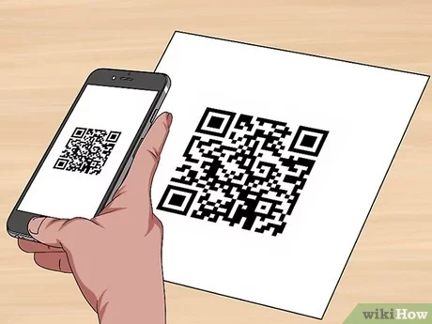
PROPOSED SYSTEM
Because we cannot use GPS modules in our mobile phones due its low accuracy in indoor environments, our proposed system uses QR codes to navigate the user in indoor environments. However, because GPS requires a straight line of sight to the satellite, these applications do not meet the demands of interior navigation. Indoor navigation systems for various infrastructures have been attempted several times. As a result, we propose to create a system for our college campus buildings that requires pasting QR codes at certain spots around the facility. By scanning the QR Code, this would aid in detecting the current user’s location and, as a result, navigation within the buildings.

Slide 6
ADVANTAGES:
* It is mainly used in large scale buildings
* It is very useful for navigating to the destination more accurately and safely
HARDWARE REQUIREMENTS:
* CPU must be minimum of Intel core i5 processor
* 8 GB RAM and above
* Must have camera to scan the QR code
SOFTWARE REQUIREMENTS:
* Android OS with version 5.0
* Must have android studio installed

Slide 7
Novelty
* Easy to reach destinations in inner locations.
* Since it is a QR based there would be no loss of inner data.
* Saves a lot of time and it is fully secured.

Slide 8
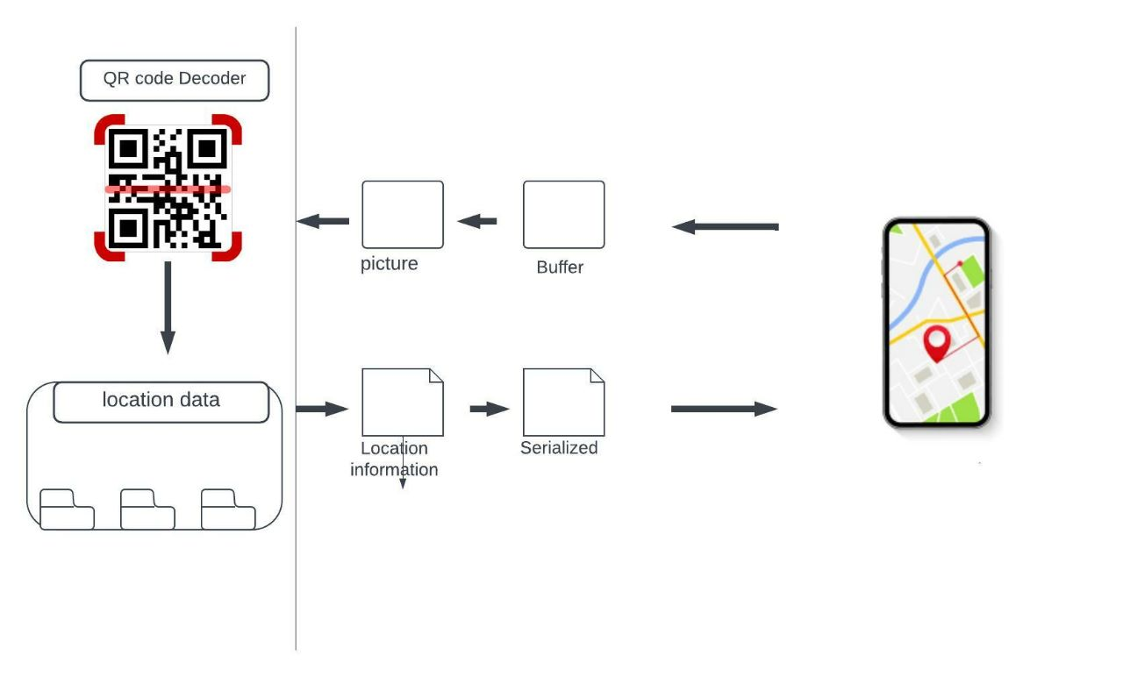
Architecture

Slide 9
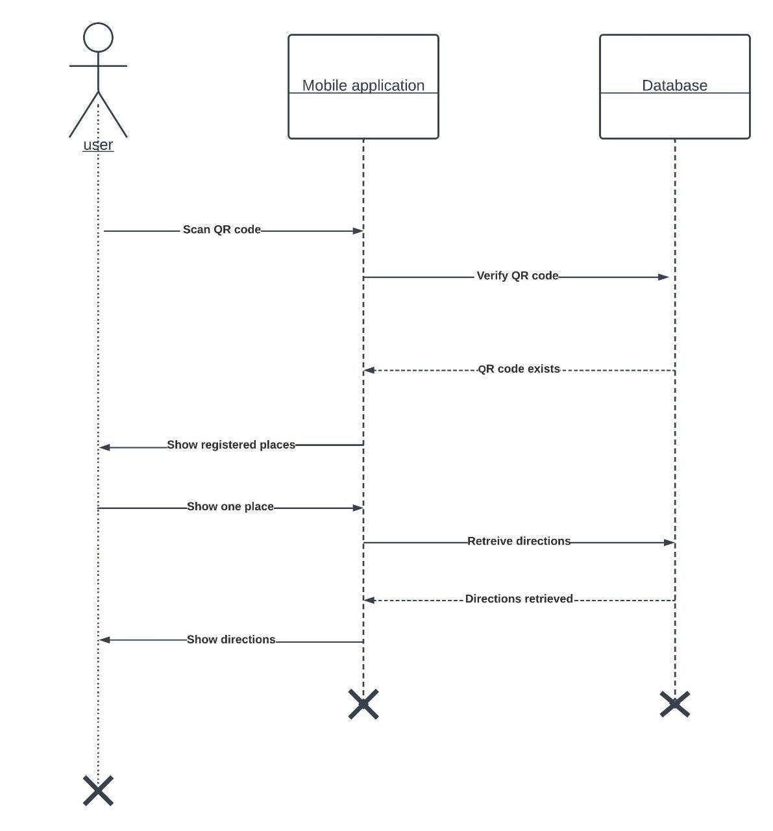
UML DIAGRAMS
SEQUENCE DIAGRAM

Slide 10
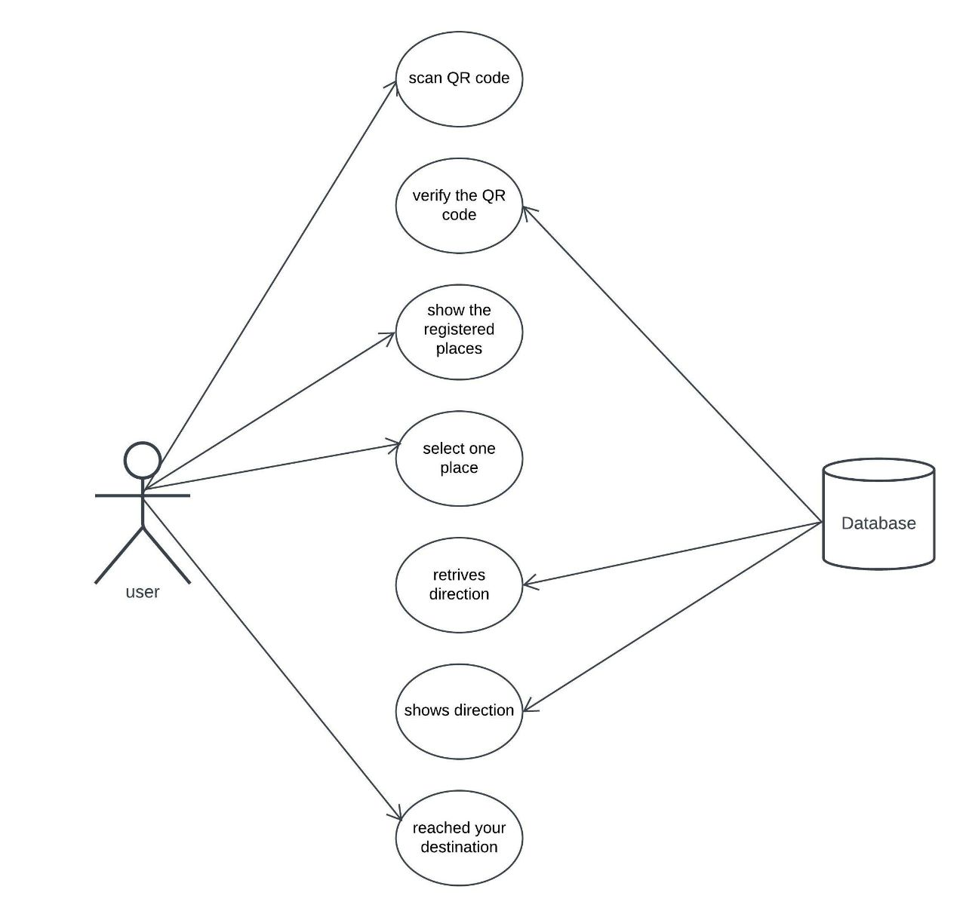
USE CASE DIAGRAM

Slide 11
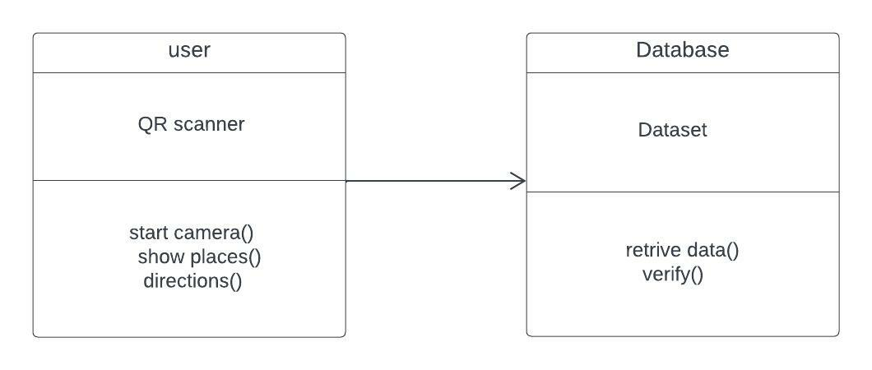
CLASS DIAGRAM

Slide 12
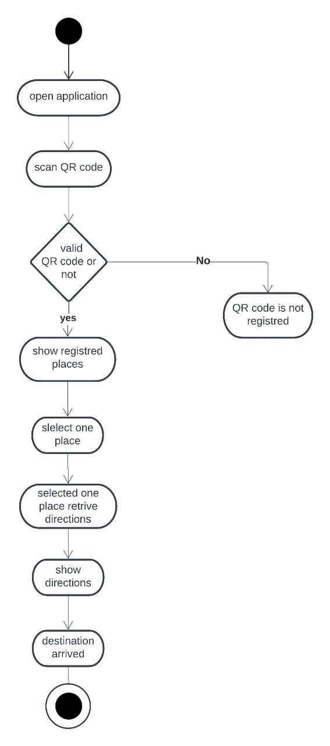
ACTIVITY DIAGRAM

Slide 13
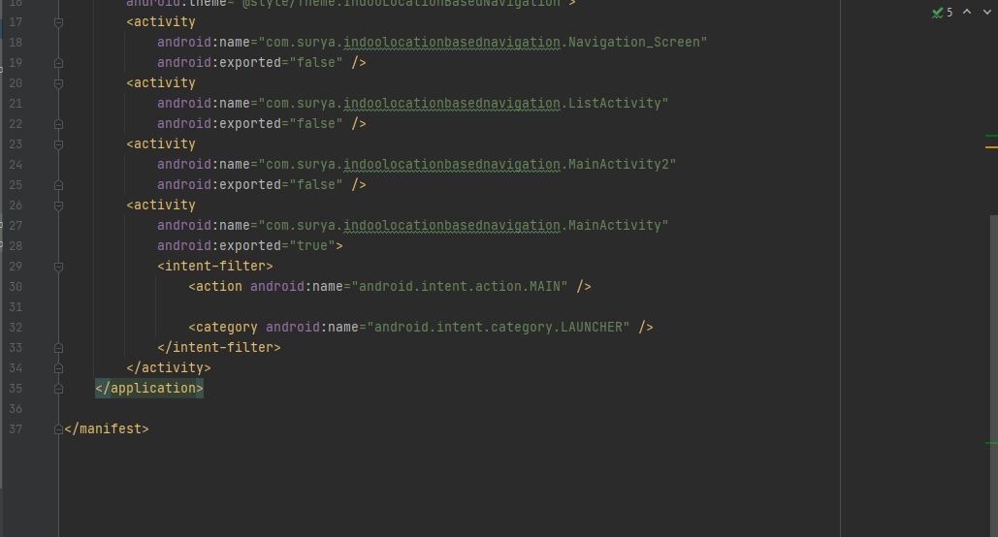
Sample Code

Slide 14
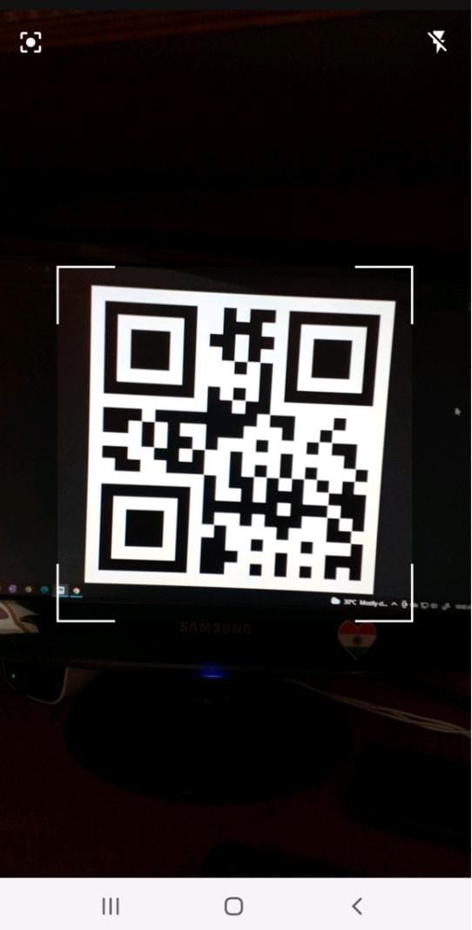
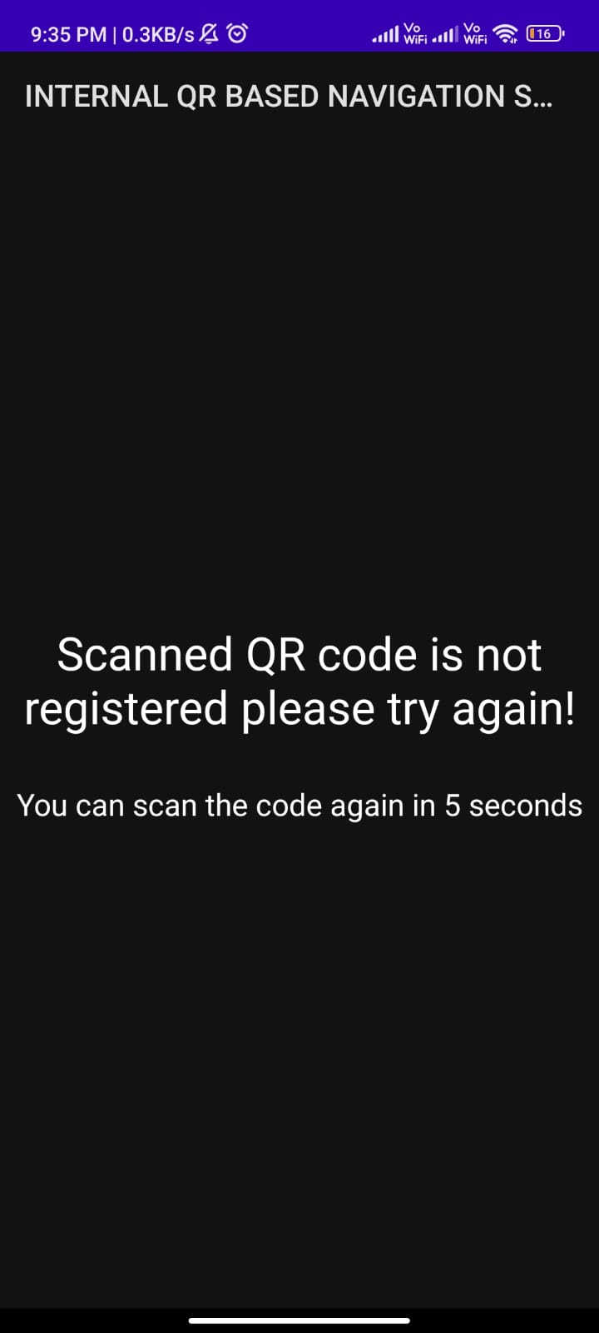
Results

Slide 15
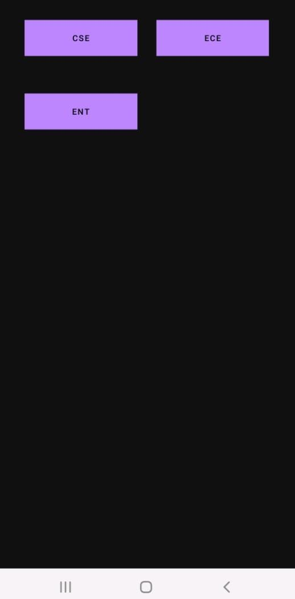
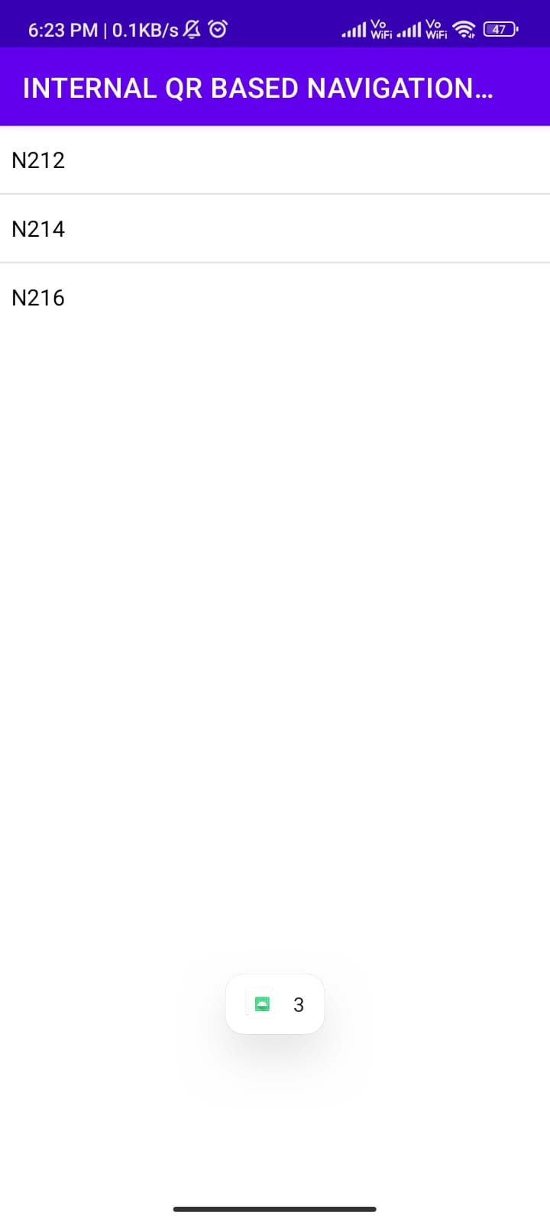

Slide 16
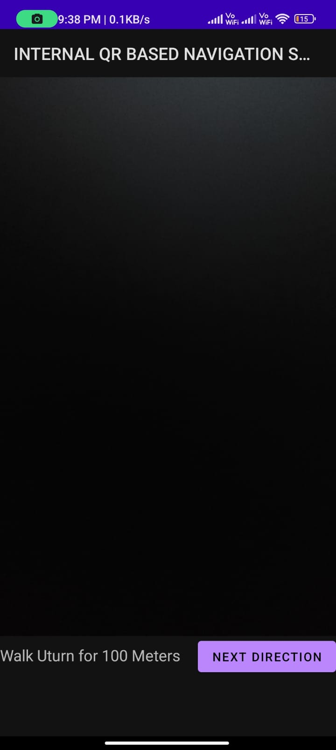
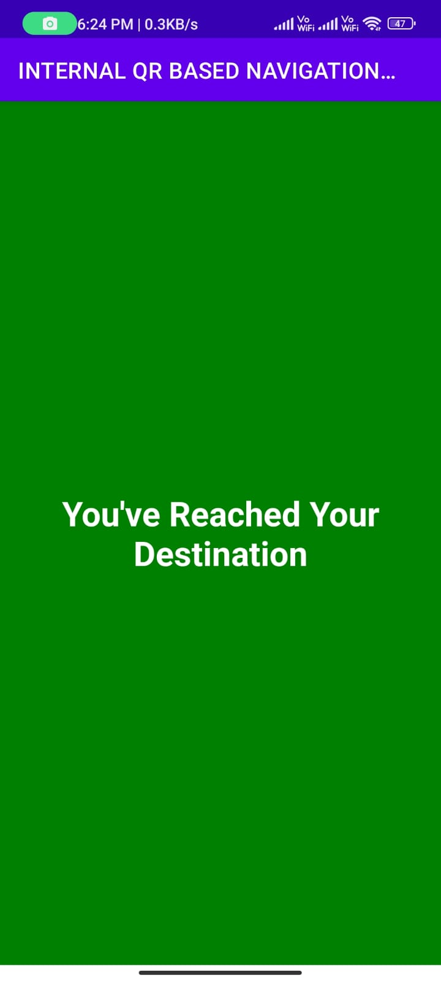

Slide 17
Conclusion
The problem of indoor navigation remains a significant difficulty because there is no generally applicable and commercially accessible navigation system for the internal environment of intelligent buildings, and such systems are not yet a standard part of smartphones. Developing a QR code-based positioning solution is a simple approach to find destinations in large indoor environments. In conclusion user can now easily navigate in indoor environments like shopping malls or college campuses if those indoor environments are registered with our application.

Slide 18
Future Enhancement
The main scope of the project is to find the indoor locations. Nowadays indoor positioning and navigation systems are becoming increasingly important as building layouts get complicated to overcome this problem we had developed an android application to find the indoor locations in large buildings, hospitals, shopping malls etc.

Slide 19
References
[1] Kajal Kumbhar3 Nutan Bankar4 Prof. U. A. Mande5 Abhimanyu Gite1, Swapnil Kamble2. Indoor navigation system using qr codes. IJMER, 5(3):473–478, 2015.
[2] Yuriy Budiyev. Qr code. Github, 2021.
[3] J. Candy. A Mobile Indoor Location-Based GIS Application. 5th International Sympo
sium on Mobile Mapping Technologies, 2007.
[4] P. Banerjee H. Liu, H. Darabi and J. Liu. Survey of wireless Indoor Positioning Tech
niques and Systems. IEEE Transactions on Systems, Man, and Cybernetics, Part C (Applications and Reviews), vol. 37, no. 6, pp. 1067–1080, 2007
[5] Sung Hyun Jang. A QR code-based indoor navigation systemusing augmented reality.
2012.
[6] Agarwal S. Nath A. Sarkar, A. Li-Fi technology: data transmission through visible. International Journal of Advance Research in Computer Science and Management Studies,
2016.

Slide 20
GitHub Link
GitHub Link : https://github.com/Gajulasandeep/internal-qr-based-navigation-system

Slide 21
THANK YOU

